Slide 1
Gateway Ordering
Release 3 Scope Discussion

Slide 2
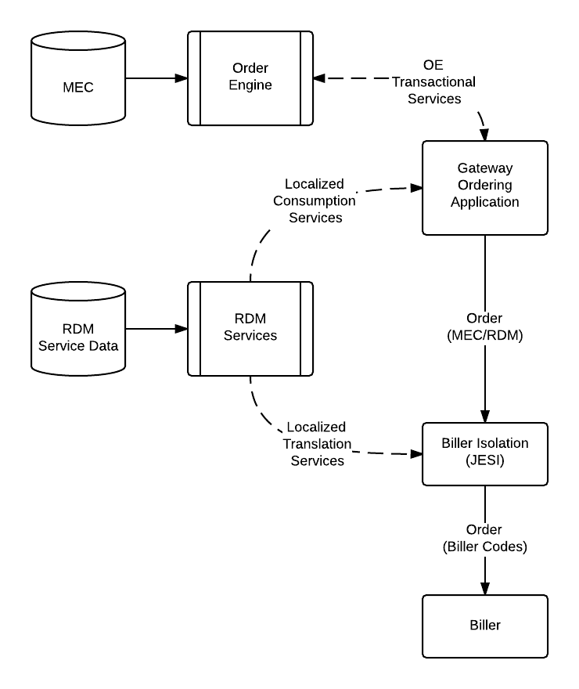
Gateway Ordering Design Tenets & Assumptions
Gateway Ordering Application Speaks MEC (Master Enterprise Catalog)
Offers are configured in MEC
MEC masters product compatibility and offer validation rules; implemented in Order Engine
MEC updated regularly to reflect offer-specific pricing from biller for presentation to application; synchronicity maintained through system audit.
Gateway Ordering presents enterprise reference data as basis for transactions
Lists of Values of RDM domains populated from consumption services presenting eligible standardized values based on ordering location.
Biller Isolation/JESI consumes reference data for translation from Enterprise to Biller-specific codes
Translation from enterprise standard to biller code may require standardization based on ordering location; may differ from eligibility localization
Notes:
Seasonal resume - just happens
Partially complete requires splitting jobs; deferred (remove from slide)
Provisioning - CSG & beyond, but there are settings in the order that impact provisioning. Assumption - we will use default values (CSR doesn't change) that have their own provisioning.
Transfers - do a single design that supports cross-biller?
Add in RTCSR (TN Portability changes)?
Order Versioning in SOLO - required for pending orders/IPO
Workflow management - deviation/out of process changes. Now don't have any way to go backward from scheduling
New address scrubber? Auto-scrubbing functionality (google-like search)
Biller first assumption
TN Administration extract - Ryan Barnes & Ginsberg

Slide 3
Release 3 Scope – Explicit Functionality
Assumptions:
Biller-first orchestration
Ordering continues to leverage default values in biller that drive provisioning
R3 Business Functionality (Order)
Customer Ordering Dashboard (Landing Page)
MEC View of orders/services
Links to view details (SOLO?)
Modify Services on Active Account
Seasonal Suspend of Active Account
Disconnect Active Account
Restart Inactive Account
Modify Existing Order
Submitted/Pending Orders
Partially Complete out of scope (requires split jobs)
Real-Time Customer Service Record changes (TN Portability)
Supporting New Technical Functionality
Order Persistence
In-memory cache (Transactional Persistence)
Write-Through to Document Store (“Save Cart”)
Adaptive Search
Business Events
Alert Correlation
Retrieval? No GO formal requirements; leverage eCommerce?
Order Versioning (SOLO)
Change Materiality Determination
Reverse Translation
Outstanding Questions
PMBI Integration
ICOMS support
Transfer? (May get traded for ICOMS support)
Migration of existing eCommerce solution for new connects (charter.com)
Containment/migration away from BOOST/BRE toward MEC/OE for other existing solutions
TN Administration extract from CSG
Address scrubbing software replacement
Notes:
Seasonal resume - just happens
Partially complete requires splitting jobs; deferred (remove from slide)
Provisioning - CSG & beyond, but there are settings in the order that impact provisioning. Assumption - we will use default values (CSR doesn't change) that have their own provisioning.
Transfers - do a single design that supports cross-biller?
Add in RTCSR (TN Portability changes)?
Order Versioning in SOLO - required for pending orders/IPO
Workflow management - deviation/out of process changes. Now don't have any way to go backward from scheduling
New address scrubber? Auto-scrubbing functionality (google-like search)
Biller first assumption
TN Administration extract - Ryan Barnes & Ginsberg

Slide 4
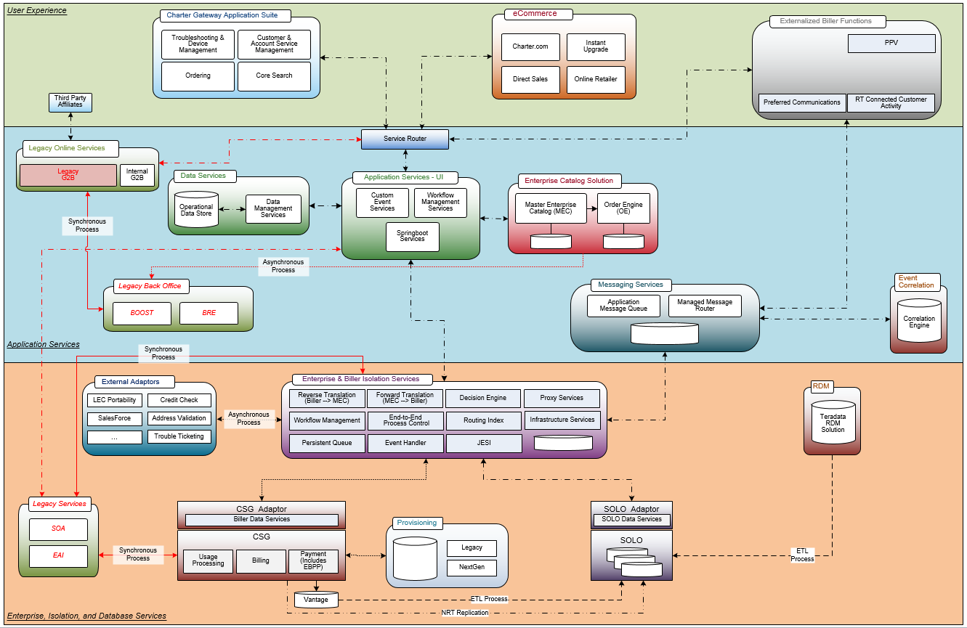
R3 Architecture (2016 Interim)

Slide 5
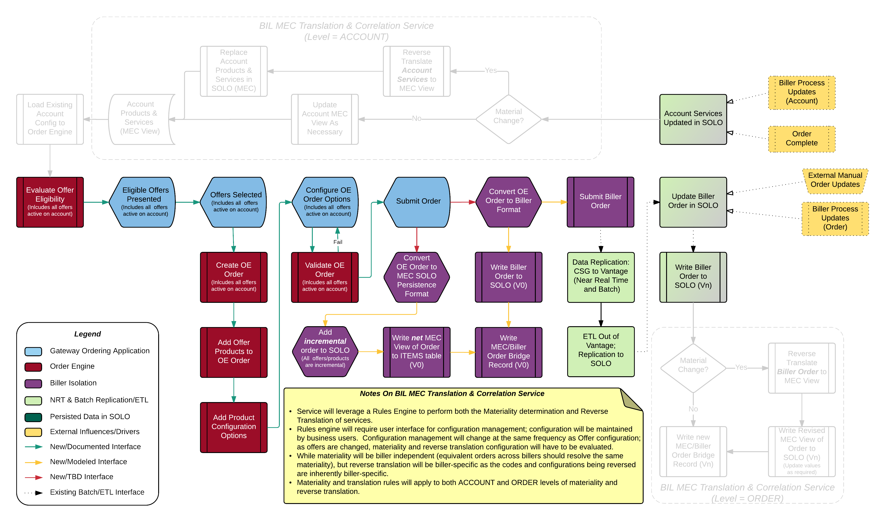
Process Flow – R2 Delivery

Slide 6
Reverse Translation
Definition: the process by which existing products and services tied to an account through biller-specific codes (and combined with prices paid and dates effective where necessary) are presented as an equivalent MEC-based offer or set of offers.
For New Connect customers (from R2)…
Assume ordered services are “deemed delivered” without change; assigned products will be created as ordered
Baseline for reverse translation algorithm efficiency
Architecture
Data
Result of reverse translation stored in SOLO (T_MEC_APITEM)
Active products/services on account: FINAL_STATUS=“ACTIVE” (final_status field is null for orders)
Requires change to SOLO to change PKs to SOLO-generated surrogates (IDs on T_MEC_ORDER_HEADER, T_MEC_APITEM, T_MEC_ATTRIBUTE_VALUE)
Staged reverse translation vs on-the-fly (OTF) translation for existing customers
Accounts can be reversed in parallel – overnight batch processing?
Reversal of attribute data from PDB?
Physical
Reverse translation performed by JESI
Dedicated HW for reverse translation (if OTF)?
Notes:
PDB/Attributes in Vantage? Not in SOLO today.

Slide 7
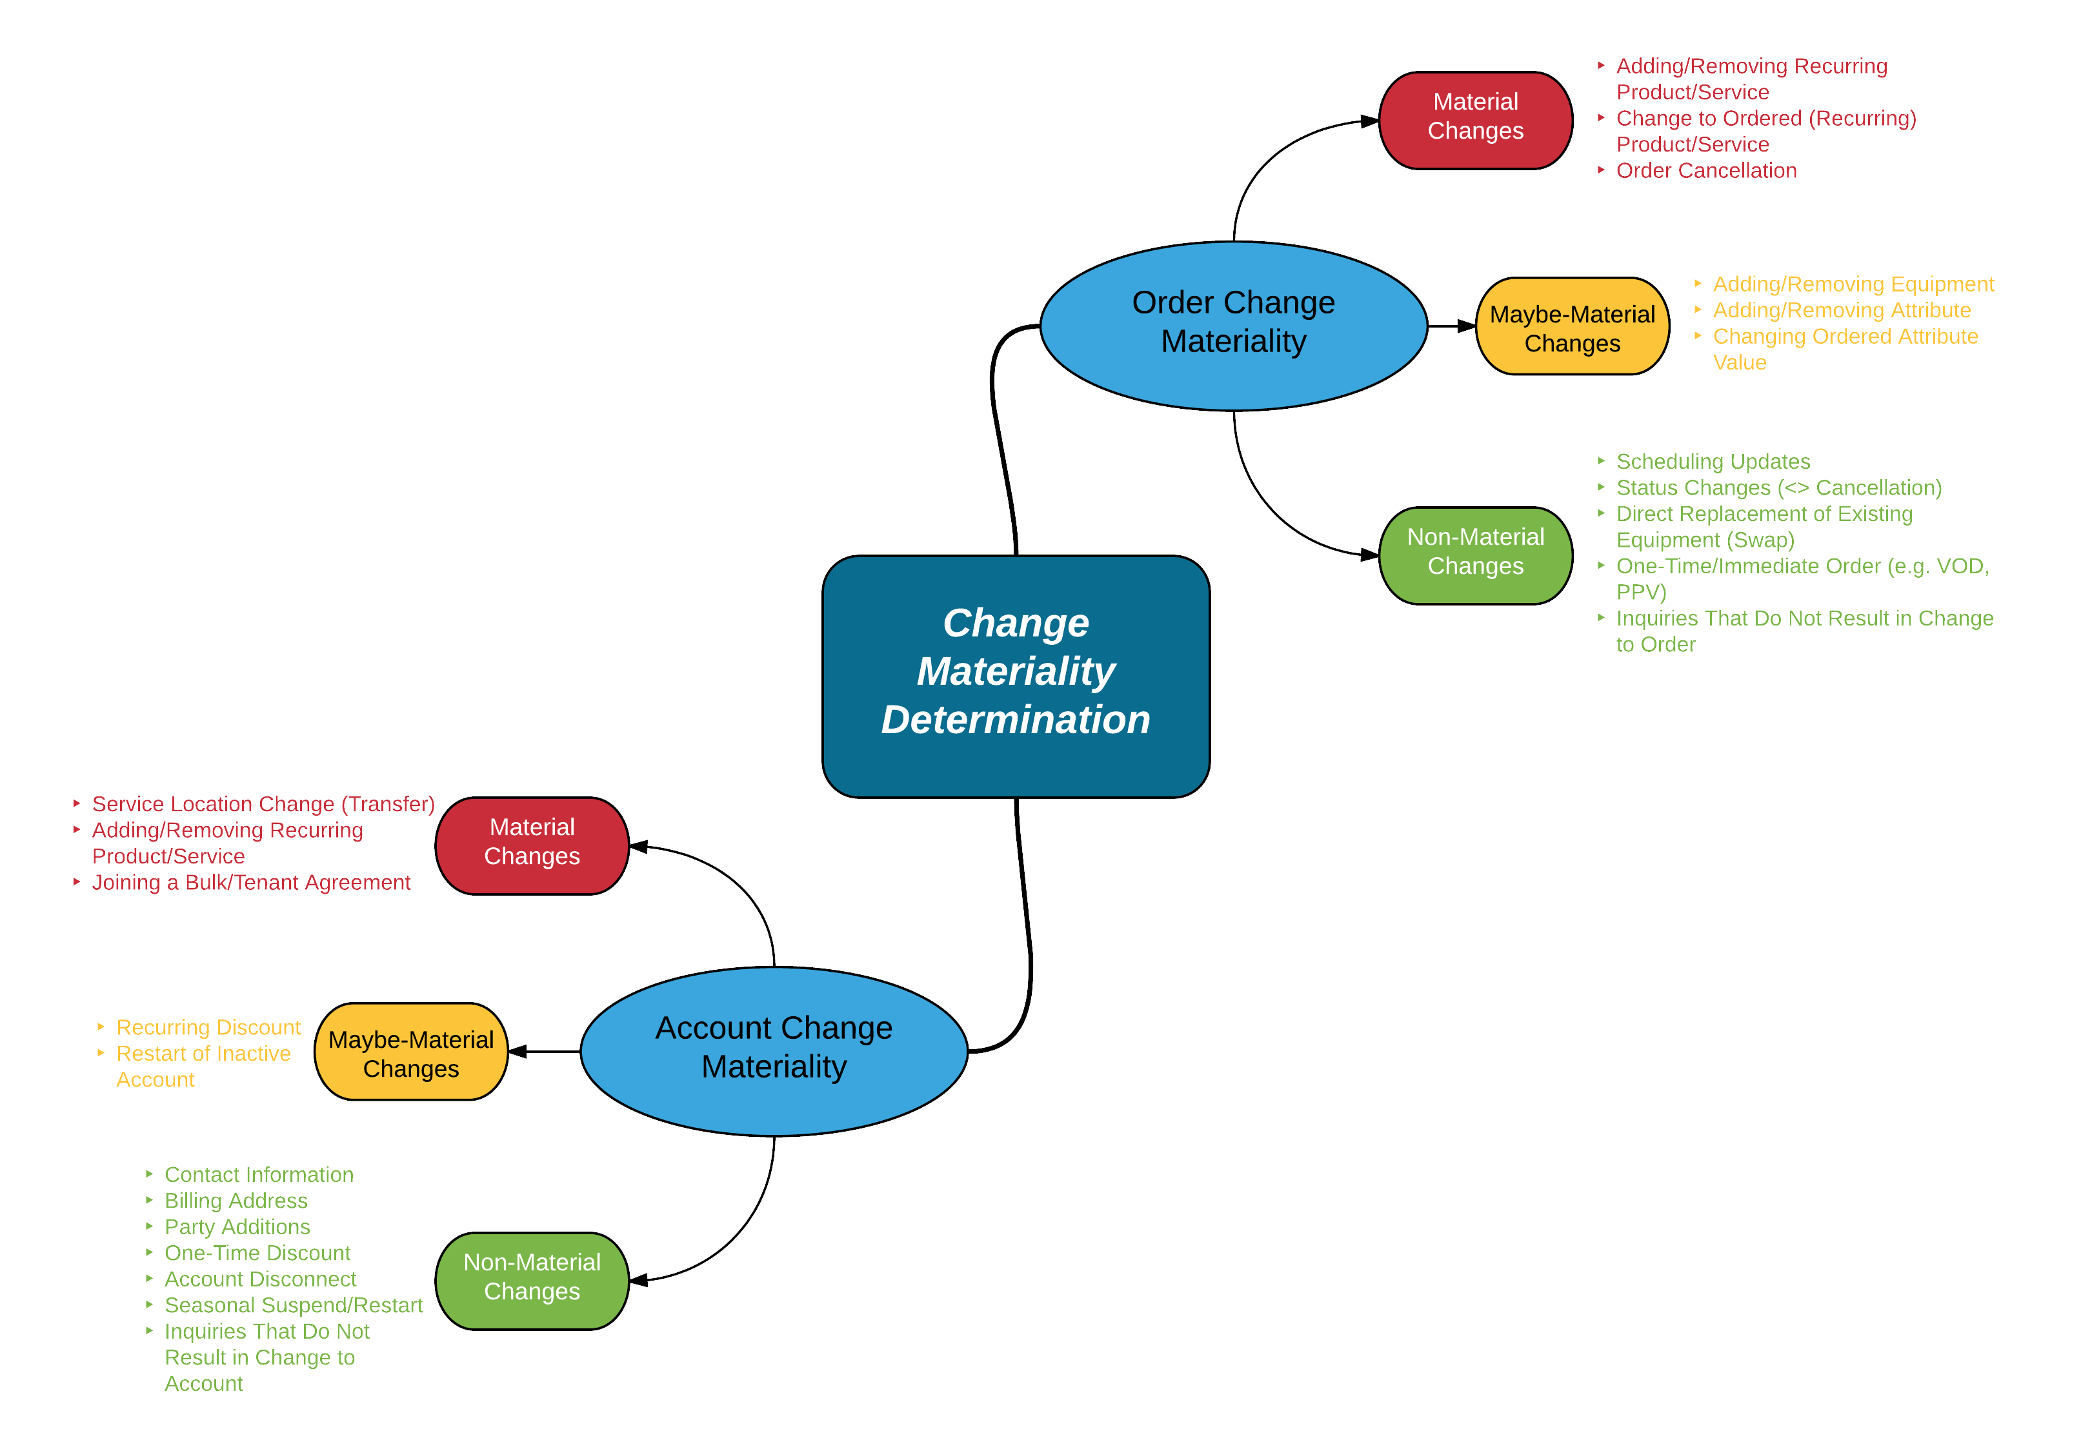
Materiality Determination
Definition: The condition whereby a change to an order or an account, caused by an external or subsequent modification to the order or account, requires a re-validation of existing MEC offer(s) or assignment of a new configuration of MEC offers, components, and attributes.
Events are illustrative only; details to be expanded in design phase
Notes:
Not material Order: Change reason code, change CSR ID

Slide 8
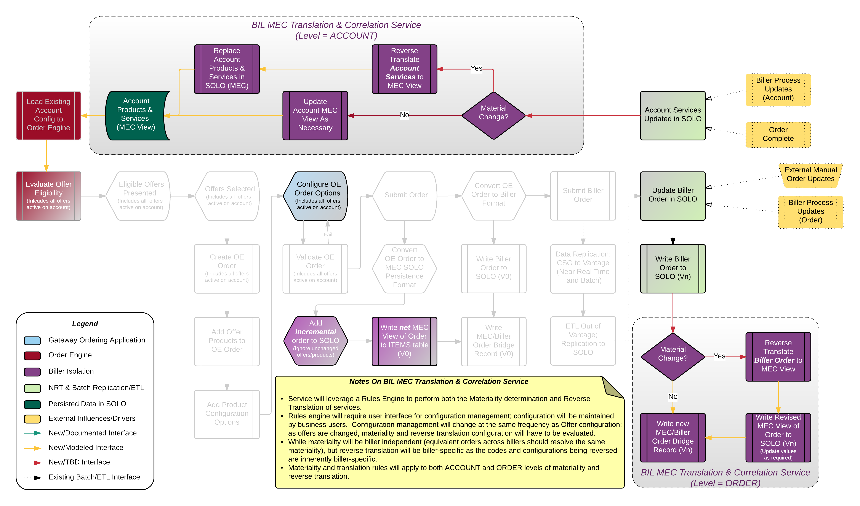

Process Flow – R3 Scope
Gateway Ordering Landing Page & Buy Flow Router
Notes:
Change Convert OE to biller as bright in R3; incremental logic

Slide 9
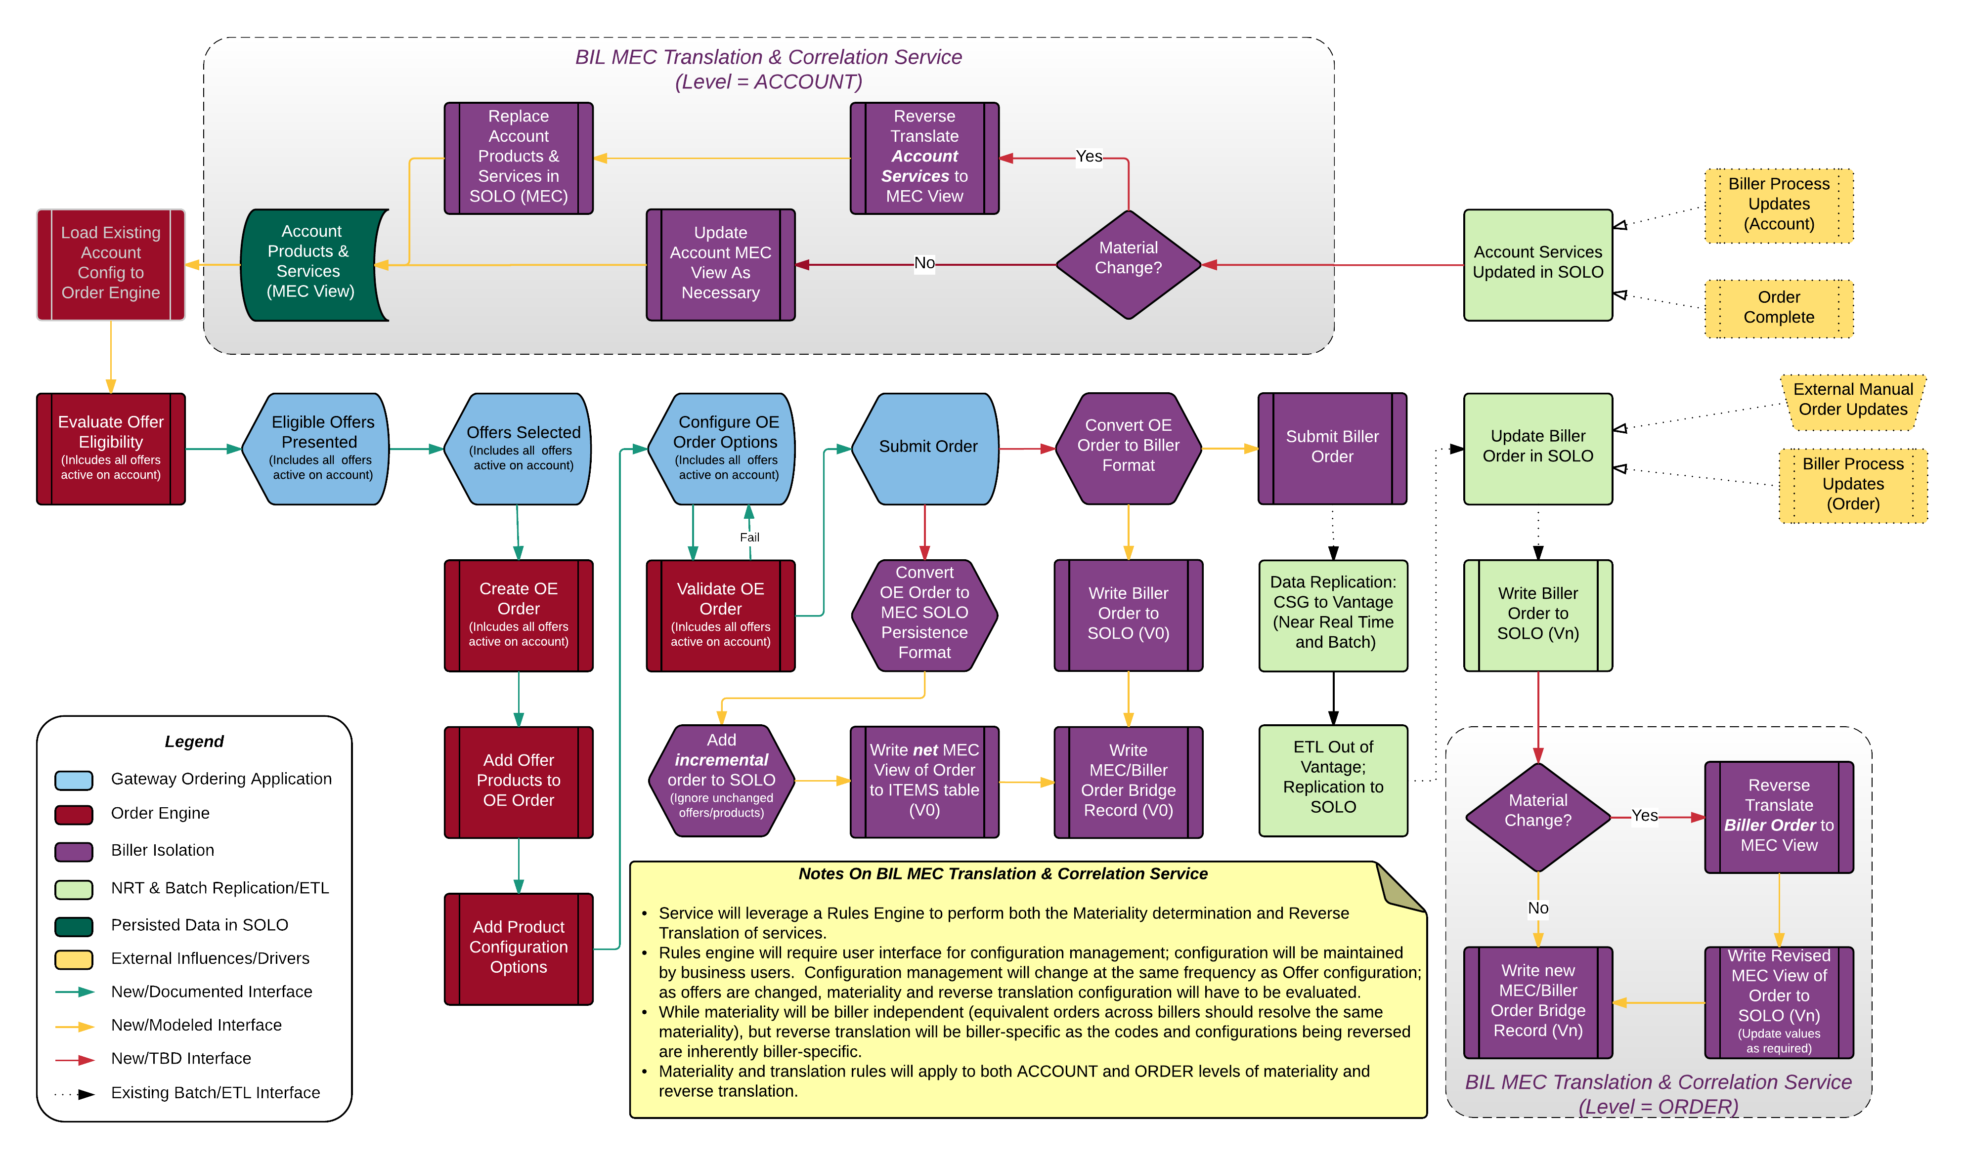
Process Flow – End State
Gateway Ordering Landing Page & Buy Flow Router
Notes:
Add Landing Page - Customer Dashboard for Ordering

Slide 10

Reverse Translation
Eliminate account codes that are not material to translation
Code Elimination for Materiality
SPA/Location Elimination
Eliminate any offer that has never been applicable for a specific SPA or location.
Eliminate any offer that is specifically for a product not active on the account.
LOB/MEC-Product Elimination
Play Elimination
Eliminate any combination of services (Play) offer that contains services that are not active on the account.
Reconcile bill price against the eligible price plans on the offer. Requires assessment of each service to apply aging to determine active price plan tier for promotional offers.
Note: discount codes may not accurately reflect active billed price; tier will likely have to be determined by service age.
Price Resolution
Apply rules that have been defined specifically to facilitate the reverse-mapping process (e.g. a promotional offer after end of promotion and a retail price offer resolve to same price; return the retail price offer)
Process Rules
Fallout: If multiple configurations resolve to the same result, manually review account history and eliminate inappropriate offer(s).
Manual Intervention
The Offer!
Woo Hoo!!

Slide 11
Reverse Translation Example
A residential customer in STL has bundled Internet (Ultra) & HD Video with HBO and Cinemax, 1 DVR and 2 additional boxes. This offer was originally promoted at $69.99/month, rising to $89.99/month in the 2nd year and going to $109.99/month retail after the end of the 2-year promotional period. This customer enrolled with this configuration in May, 2014. Their current monthly bill is $154.69, including taxes and fees.
Step(s) | Effect
Code Elimination for Materiality | Remove any codes from the account configuration that do not affect materiality (e.g. Spectrum Guide Rate Code, install code, wire maintenance code)
SPA/Location Elimination | Eliminate any offers that are exclusively localized outside the STL area
LOB/MEC-Product Elimination | Since the customer does not have Charter telephone service, eliminate any offers that include telephone/voice products
Play Elimination | Eliminate any offers that include play combinations outside the TV/Internet bundle
At this point in the process we should be reduced to a minimal number of offers: Retail Double Play TV/Internet, Promotional Double Play TV/Internet offer(s), TV-only and Internet-only (Note: since we only have biller-specific codes on the account, we can’t eliminate the SP offers at this time as these could have been purchased independently)
Price Resolution | Knowing the customer is now paying in the 2nd year of the promotional offer eliminates the Retail and TV-Only & Internet-Only offers, resolving to 1 or more promotional offers. It will be important to resolve to component-based pricing here; additional services like HBO/Cinemax, DVR, and additional boxes can mask promotional bundle pricing and add complexity to the rules
Process Rules | Rules-based processing on promotional offer aging and additional services resolves the current price being paid to a specific offer with optional add-on components selected
Manual Intervention | Should not be required in this case

Slide 12
Materiality & Reverse Translation Platform
Capability Requirements:
Access to Master Enterprise Catalog configuration and translation data
Assumes that the component-based pricing of the MEC offer remains synchronized with biller
Assumes all offers (including expired offers) are available as targets for reverse translation
Access to enterprise code and biller code standardization and localization data from RDM
Reverse translation will resolve to enterprise codes where appropriate
On-The-Fly scalability for instantiating SQL and rules-processing engines
Materiality determination requires rules-based processing for both Order and Account (separately)
Price resolution (comparison of published price with applied discounts) to actual billed price requires a combination of both rules and math-based logic processing
Custom process logic (specifics TBD) is envisioned as another implementation of rules engine processing
Manual fallout processing will require access for CSR to review account history
Biller isolation queries for Gateway customers; biller access for unconverted legacy customers
Results of Reverse Translation (both order and account) will be stored in Operational Data Store for future application processing; Gateway Ordering begins with a MEC-based view of services on an account.

Slide 13


Slide 14
Backup Slides

Slide 15
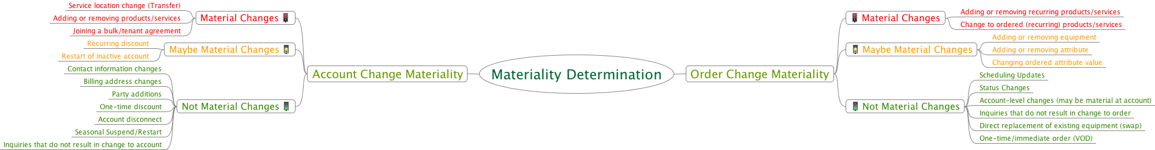
Materiality Determination
Definition: The condition whereby a change to an order or an account, caused by an external or subsequent modification to the order or account, requires a re-validation of existing MEC offer(s) or assignment of a new configuration of MEC offers, components, and attributes.
Two (related, but independent) levels of Materiality:
Order
Account
Events are illustrative only; details to be expanded in design phase

Slide 16
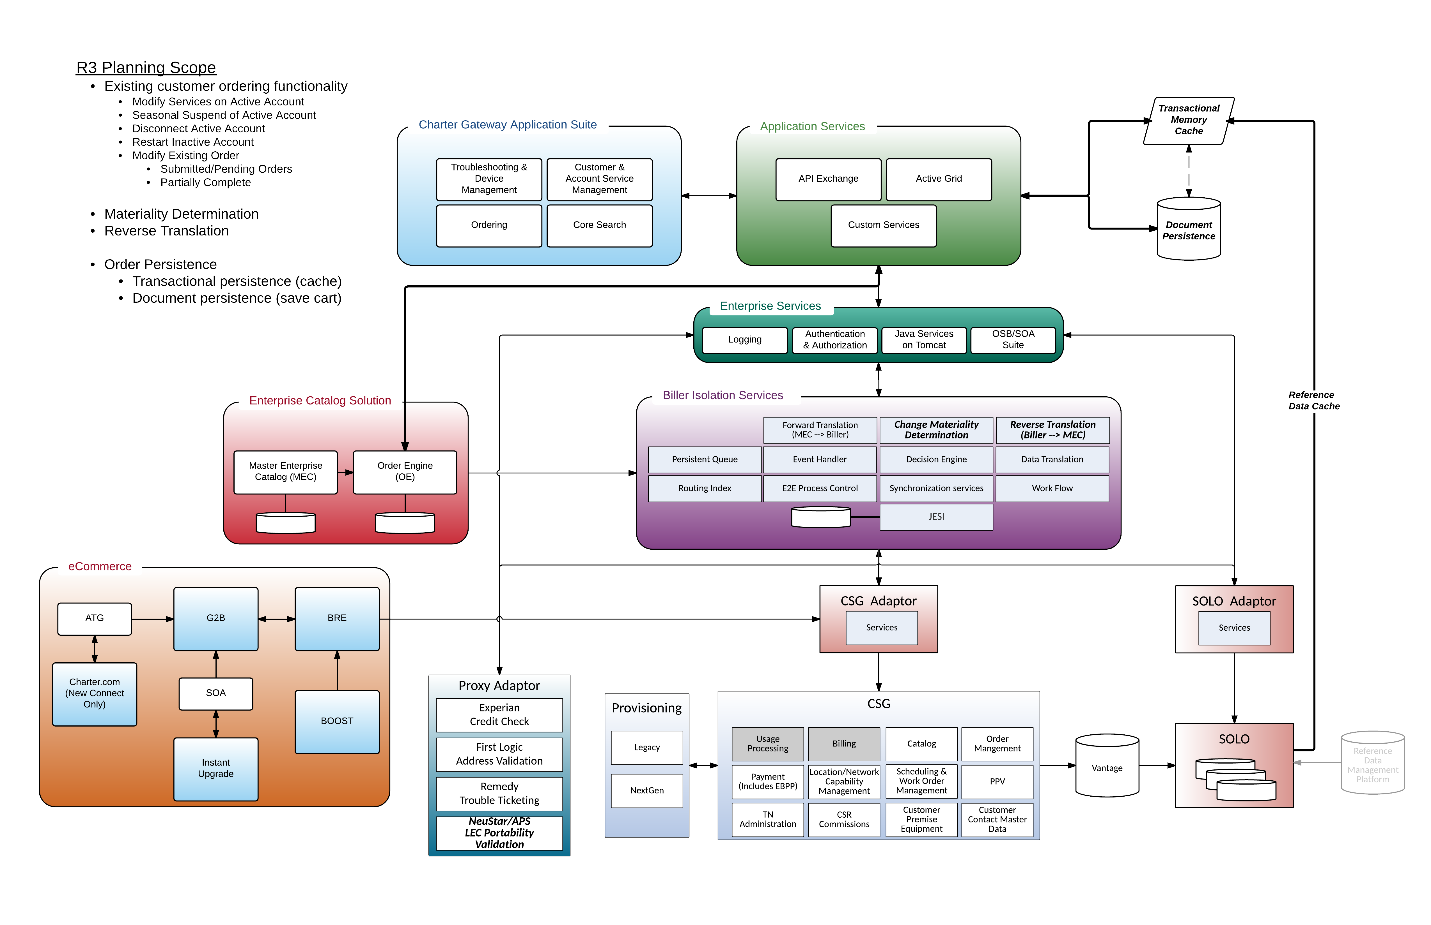
R3 Architecture (Alternate)

Slide 17
Reverse Translation (Old)
1. SPA/Location Elimination
Eliminate any offer that has never been applicable for a specific SPA or location.
2. LOB/MEC-Product Elimination
Eliminate any offer that is specifically for a product not active on the account.
3. Play Elimination
4. Price Resolution
Eliminate any combination of services (Play) offer that contains services that are not active on the account.
Reconcile bill price against the eligible price plans on the offer. Requires assessment of each service to apply aging to determine active price plan tier for promotional offers.
Note: discount codes may not accurately reflect active billed price; tier will likely have to be determined by service age.
5. Process Rules
Apply rules that have been defined specifically to facilitate the reverse-mapping process (e.g. a promotional offer after end of promotion and a retail price offer resolve to same price; return the retail price offer)
6. Manual Intervention
If multiple configurations resolve to the same result, manually review account history and eliminate inappropriate value(s).
The Offer!!
Woo Hoo!!
Assumptions and Clarifications
All offers (both current and historical) are always available; can expire but are not deleted from repository
All MEC reference data will be available for consumption in reverse process; includes the forward-translation, biller specific, mapping table.
Reverse Engineering process will need to consider both active services as well as any pending services to be activated (pending orders)
Notes:
Step 6 will likely require a UI - where does it live?
Who owns account cleanup (Evan G's old organization?)

Slide 18
Reverse Translation and RDM Platform
RDM has been proposed as a platform to drive reverse translation – not optimal solution
Not all account codes will be material (requiring reversal)
Materiality evalution is also a rules-based processing requirement
Not a static process, so static data mappings and filters provide only part of the solution
Reverse translation requires implementation of rules-based approach, especially around promotional pricing
RDM could drive portions of reverse translation if…
All historical values maintained in RDM and presented through services (not just presently active)
RDM managed offer/component relationships and validation rules
Reverse translation rules could be defined independent of price- and time-sensitivity
Notes:
Seasonal resume - just happens
Partially complete requires splitting jobs; deferred (remove from slide)
Provisioning - CSG & beyond, but there are settings in the order that impact provisioning. Assumption - we will use default values (CSR doesn't change) that have their own provisioning.
Transfers - do a single design that supports cross-biller?
Add in RTCSR (TN Portability changes)?
Order Versioning in SOLO - required for pending orders/IPO
Workflow management - deviation/out of process changes. Now don't have any way to go backward from scheduling
New address scrubber? Auto-scrubbing functionality (google-like search)
Biller first assumption
TN Administration extract - Ryan Barnes & Ginsberg

